Slide 1
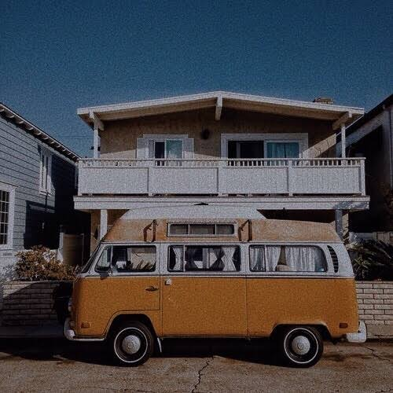
SAFEJOURN
Members:
M. Shaheryar Khalid
Fizza Jawed
Arbaz Khan
Supervisor:
Dr. Zulfiqar Memon
Co-supervisor:
Sayed Yousuf

Slide 2

OUTLINE
Product overview
Background and Problem Statement
Key Features
Diagrammatic Representation
How SafeJourn is Different?
Technologies to be used

Slide 3
PRODUCT OVERVIEW
Product Name: SafeJourn
Users: Drivers and Parents
Phenomena of Airlift/Swvl
How is it different from it?

Slide 4
BACKGROUND AND PROBLEM STATEMENT
Problem
-Children safety
-Monitoring
-Tracking
Solution

Slide 5
KEY FEATURES:
Real-time Tracking
Registration
Notifications
Bio-metric attendance
Routes using real-time Traffic

Slide 6
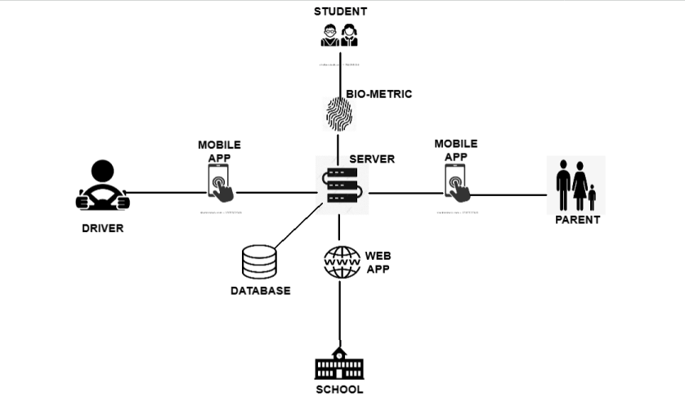
DIAGRAMMATIC REPRESENTATION OF SAFEJOURN

Slide 7
HOW SAFEJOURN IS DIFFERENT?
Working for registered organizations independently
Attendance record
Real-time tracking
SafeJourn will provide different panels for Parents and organization
Only registered drivers can operate
Start and end of Journey Alerts
Safety for children.
Faster travel with Google traffic API’s.

Slide 8

TECHNOLOGIES
React Native – App Development
React Js – Web Development
Java – Backend Development/ Server-side Development
MySQL – Database
Biometric Scanning – Attendance

Slide 9
THANK YOU

